Slide 1

Infosys Springboard AI Contract Analyzer
AI Tool to Read and Analyze Legal Contracts Automatically
Submitted To : Aabid M K
MENTOR
Created by : Rishi Raj Singh
Date : 05/03/2026

Slide 2
AI Contract Analyzer
Automated Legal Contract Analysis using Vector Search, LLMs, LangGraph, FastAPI, and a Modern AI Dashboard

Slide 3
Project Objective
Build an AI system that analyzes legal contracts, retrieves similar clauses, performs expert-style analysis, and generates a professional legal review report.

Slide 4
Problem Statement
Manual contract review is slow and error‑prone.
Legal experts must identify risks, missing clauses, and compliance issues.
The goal is to automate contract analysis using AI.

Slide 5
System Architecture
Document Upload → Vector Retrieval → LLM Analysis → Role-based Expert Review → Final Report → API + UI Dashboard

Slide 6
Vector Database Initialization
Clause dataset stored in clause.json
Embeddings created using sentence-transformers
Stored in Chroma Vector Database
Used for similarity-based clause retrieval

Slide 7
Similarity-Based Retrieval
User contract text converted to embeddings
Top similar clauses retrieved from vector database
Filtering applied based on contract type

Slide 8
Analyze Contract Node
LLM compares user contract with retrieved clauses
Detects inconsistencies
Suggests improvements
Identifies missing standard clauses

Slide 9
Role-Based Review Planning
create_review_plan_node generates expert roles
Examples:
• Contract Lawyer
• Compliance Officer
• Risk Analyst
• Financial Auditor

Slide 10
Parallel Role-Based Analysis
execute_step_node performs expert review
Each role analyzes contract from a different legal perspective
Produces independent expert findings

Slide 11
Final Report Generation
generate_final_report_node compiles results
Creates professional structured report:
Executive Summary
Risk Assessment
Missing Clauses
Recommendations

Slide 12
FastAPI Backend
Endpoints:
POST /analyze – Upload contract
GET /result/{task_id} – Retrieve analysis
Background processing runs LangGraph pipeline
Task metadata and reports stored

Slide 13
Modern AI Dashboard UI
Minimal attractive interface
Upload contracts
Live processing status
Vector search insights
Role-based analysis
Final report display

Slide 14
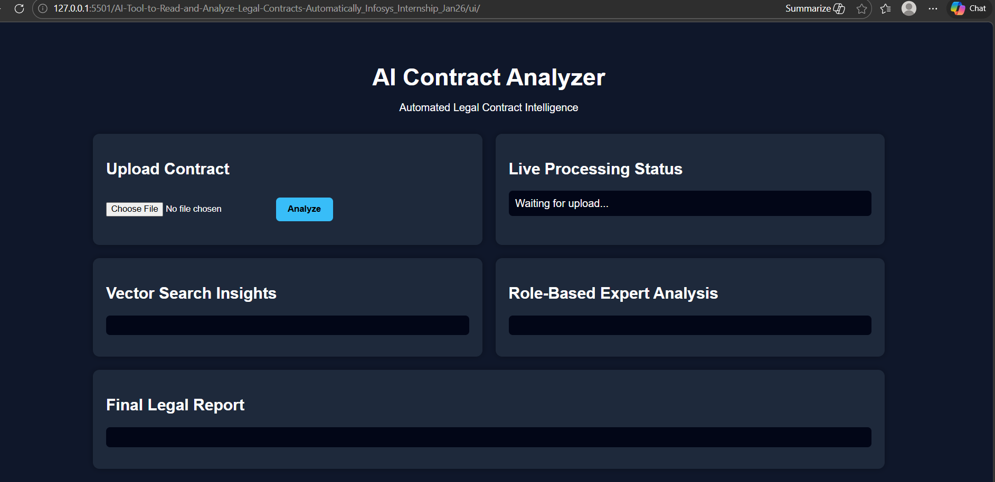

Slide 15
Technology Stack
Python
LangGraph
Chroma Vector Database
Sentence Transformers
Ollama (phi3:mini LLM)
FastAPI
HTML / CSS / JavaScript UI

Slide 16
End-to-End Workflow
1. User uploads contract
2. Contract stored and task ID generated
3. Vector DB retrieves similar clauses
4. LLM analyzes differences
5. Expert roles review contract
6. Final report generated
7. UI displays results

Slide 17
Impact & Benefits
Faster contract review
Automated legal insights
Reduced manual workload
Scalable AI-based legal analysis

Slide 18
Future Enhancements
Risk scoring system
Clause similarity visualization
Compliance checking engine
PDF export for reports
Multi-language contract analysis

